Slide 1
Mandatory Retention: Iowa Rethinks an Unproven and Expensive State Policy
Margaret Buckton
Administrator Days, Kearney, NE July 27, 2018

Slide 2
Agenda Today
Iowa change: context for reading achievement
Education Reform: Iowa’s 3rd Grade Retention Policy 2012 compared to NE’s L651
Research behind 3rd-grade retention
Intersection of Core Values and Public Policy
Advocacy steps and messages

Slide 3
Hello from Iowa
Rich soil
Rivers, transportation, irrigation
Strong work ethic
Fairly homogenous, mostly European immigrant roots until recently
Historically strong education system and results:
Still #1 in high school graduation rate
Used to be in top 5 in nearly all NAEP metrics
Now in the middle of the pack
Why the change?

Slide 5
Free and Reduced Lunch Percentage of Enrollment by School District 2001 (Darkest quintile is greater than 42% Eligibility)

Slide 6
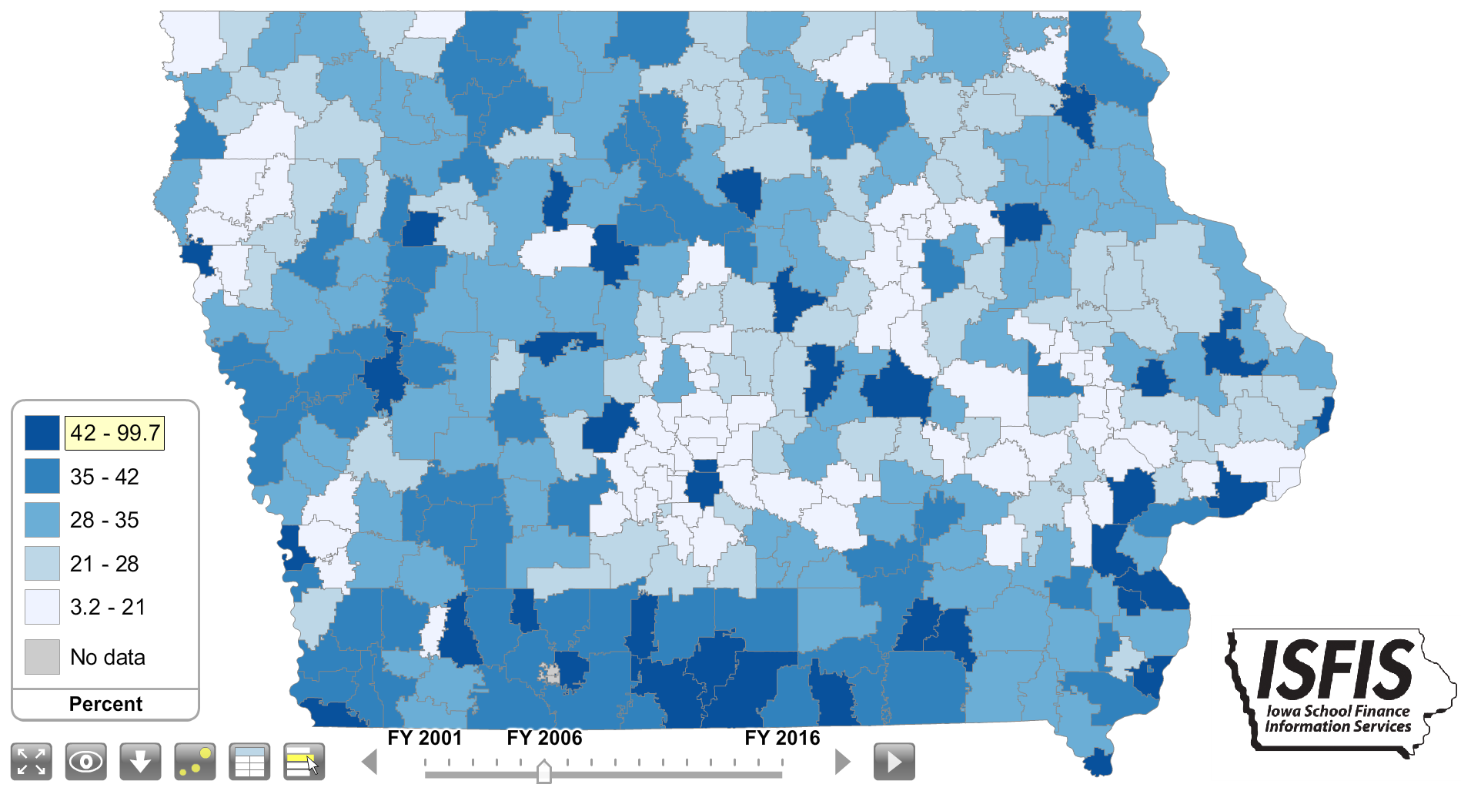
Free and Reduced Lunch Percentage of Enrollment by School District 2006 (Darkest quintile is greater than 42% Eligibility)

Slide 7
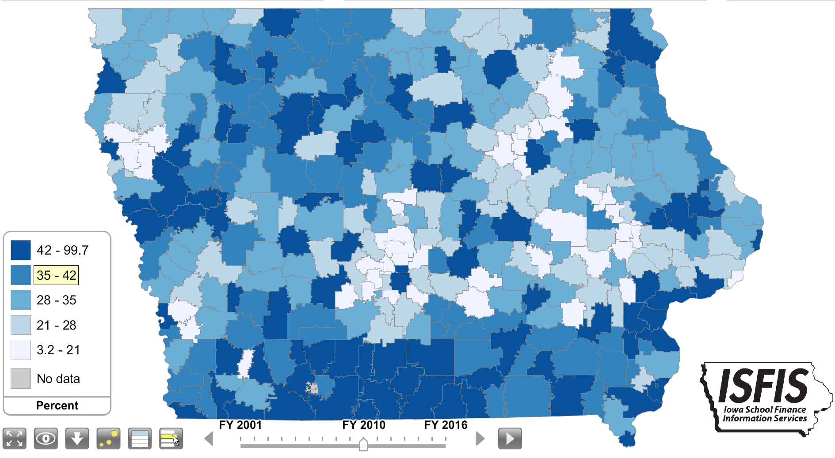
Free and Reduced Lunch Percentage of Enrollment by School District 2010 (Darkest quintile is greater than 42% Eligibility)

Slide 8
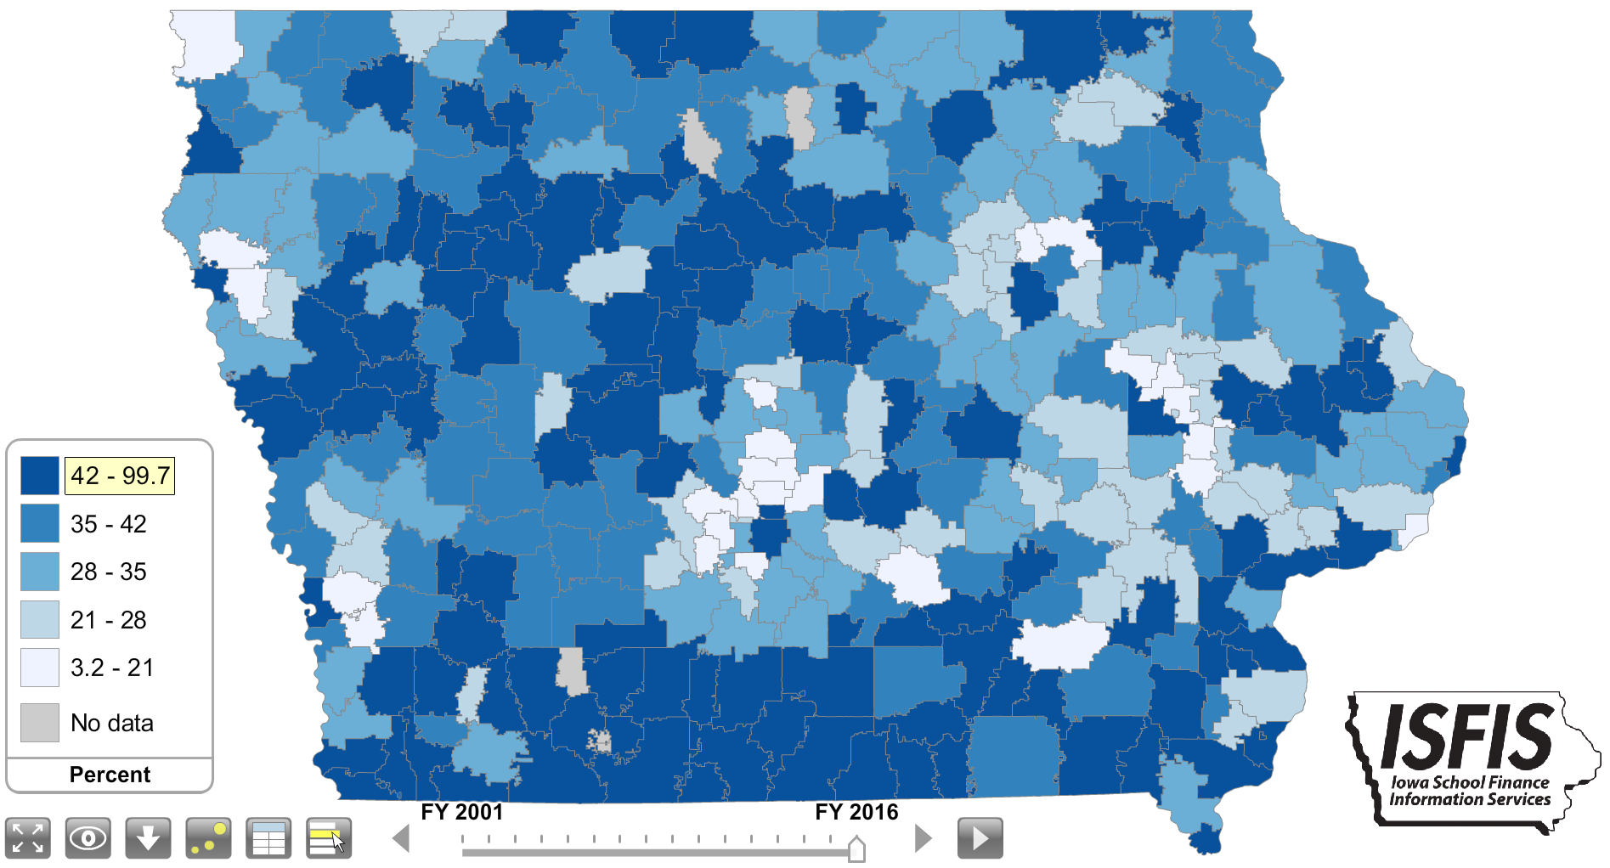
Free and Reduced Lunch Percentage of Enrollment by School District 2016 (Darkest quintile is greater than 42% Eligibility)

Slide 9
From 2001 to 2016, Iowa schools have experienced:
Near doubling of percent of children in poverty
133% increase in minority students
149% increase in English-language learners
Des Moines in 2016 had 6,567 LEP students, which would rank the LEP program in DMPS as the 15th largest school district in the state.

Slide 10
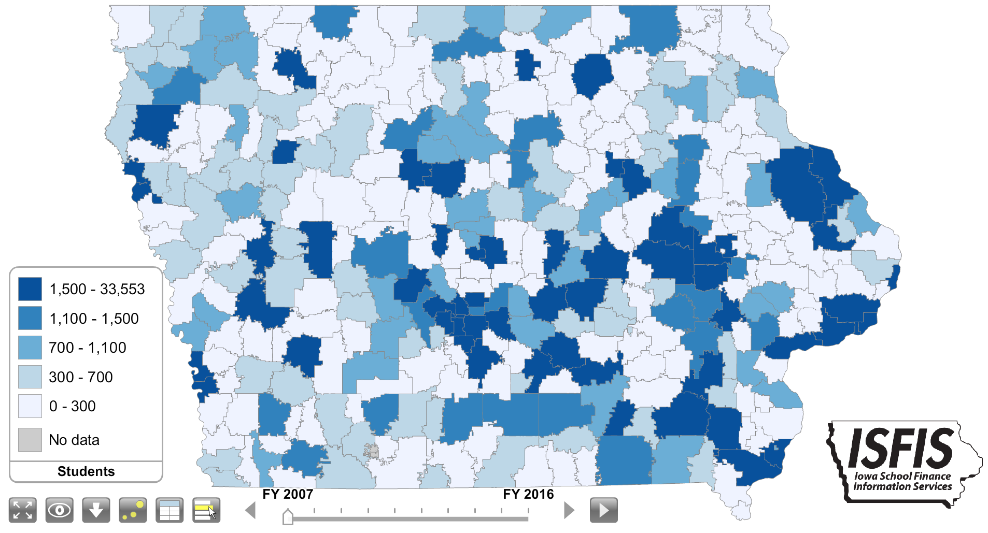
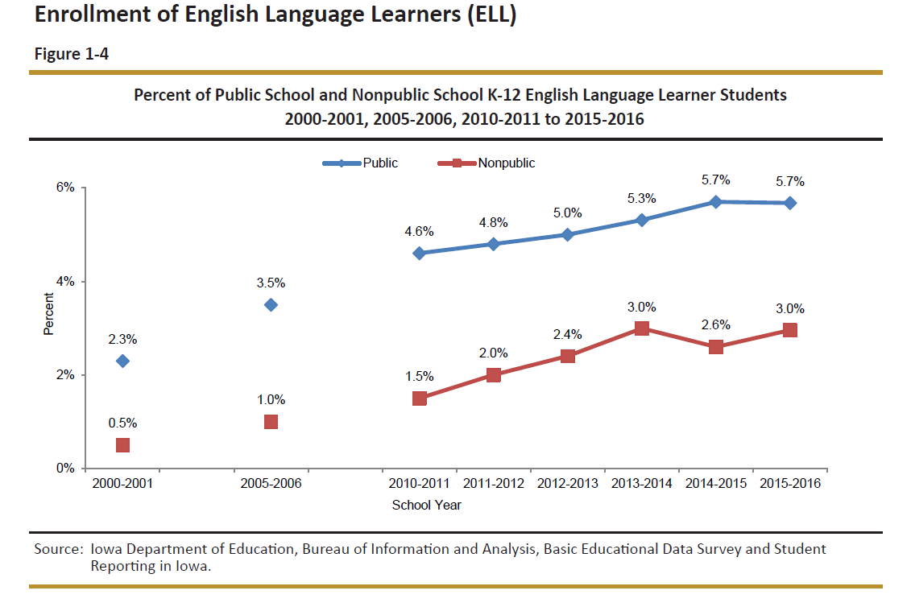
Limited English Proficient:

Slide 11
Data Question for you:
Given Iowa’s changing demographics, what would you predict would be happening to Iowa’s 4th Grade NAEP math and reading scores over the last 15 years?

Slide 12
Iowa and USA NAEP 4th Grade Scale Scores

Slide 13
Look again, with 0 minimum Axis:

Slide 14
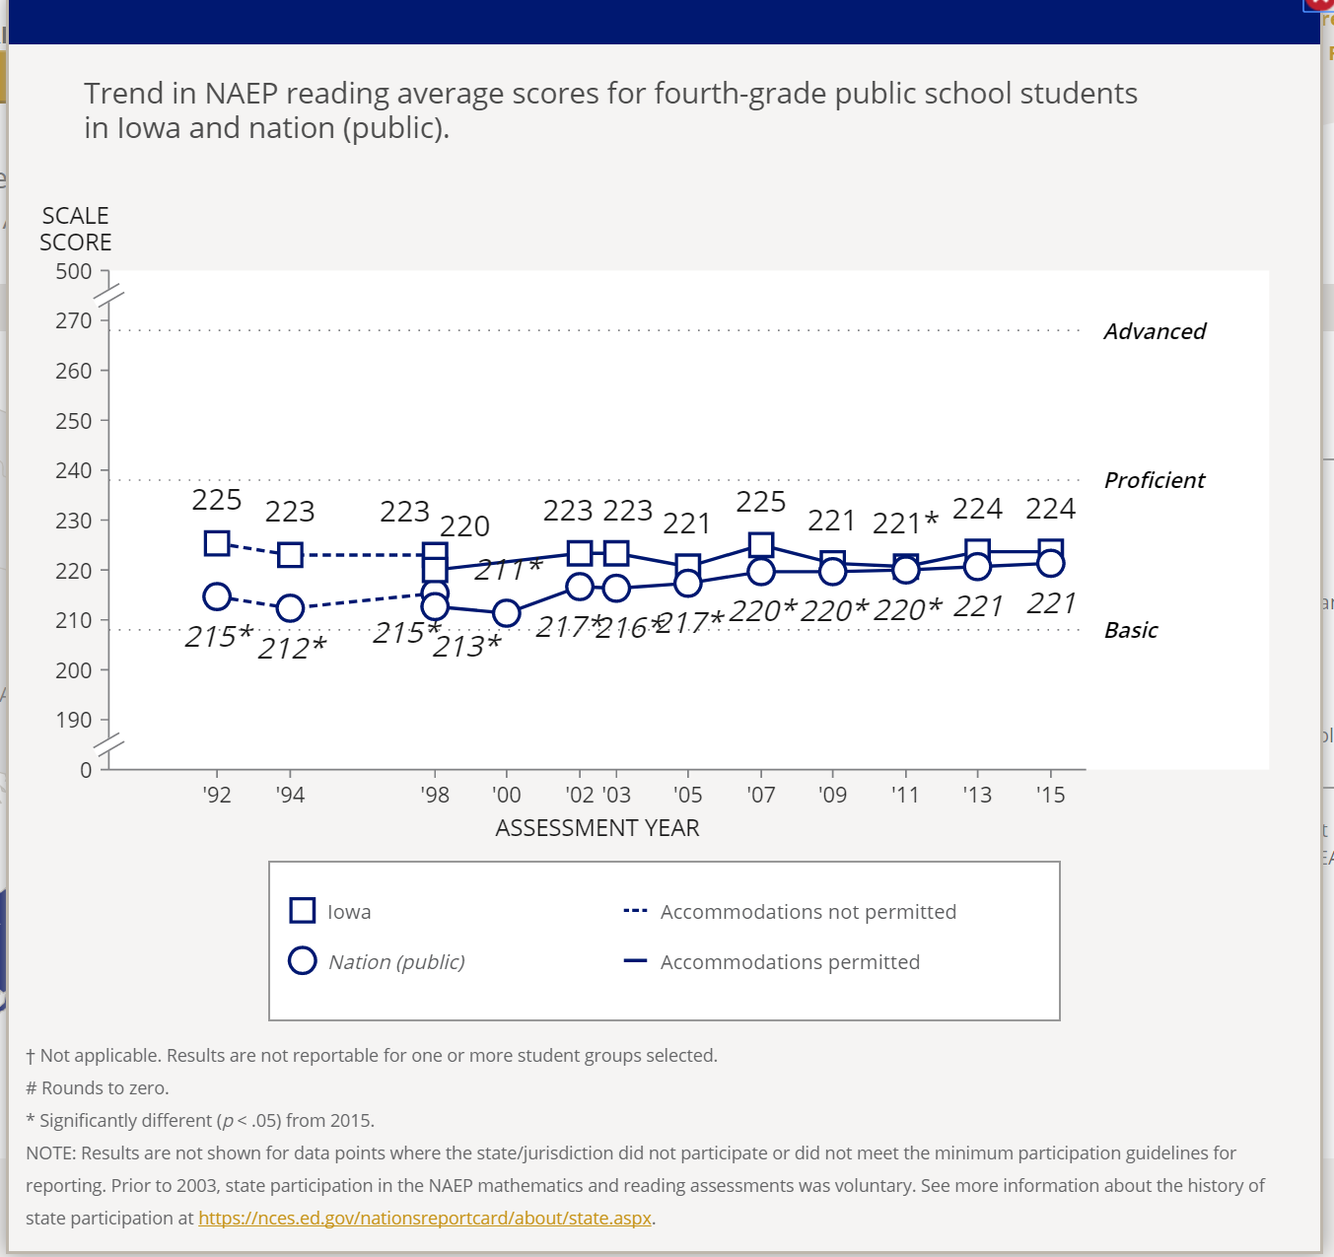
Iowa 4th Grade NAEP Trends

Slide 15
Historically…
Retention has been a parent-based, teacher-based, school-based, or district-based policy
Since the advent of No Child Left Behind, it is increasingly becoming a state policy issue
Public perception of failing schools, leaving children behind, has pressured politicians to find state-level solutions
Legislators may not truly understand the problem or depend on the same scientific research-based best practice that educators know make the biggest difference for students. They have a political calculus.

Slide 16
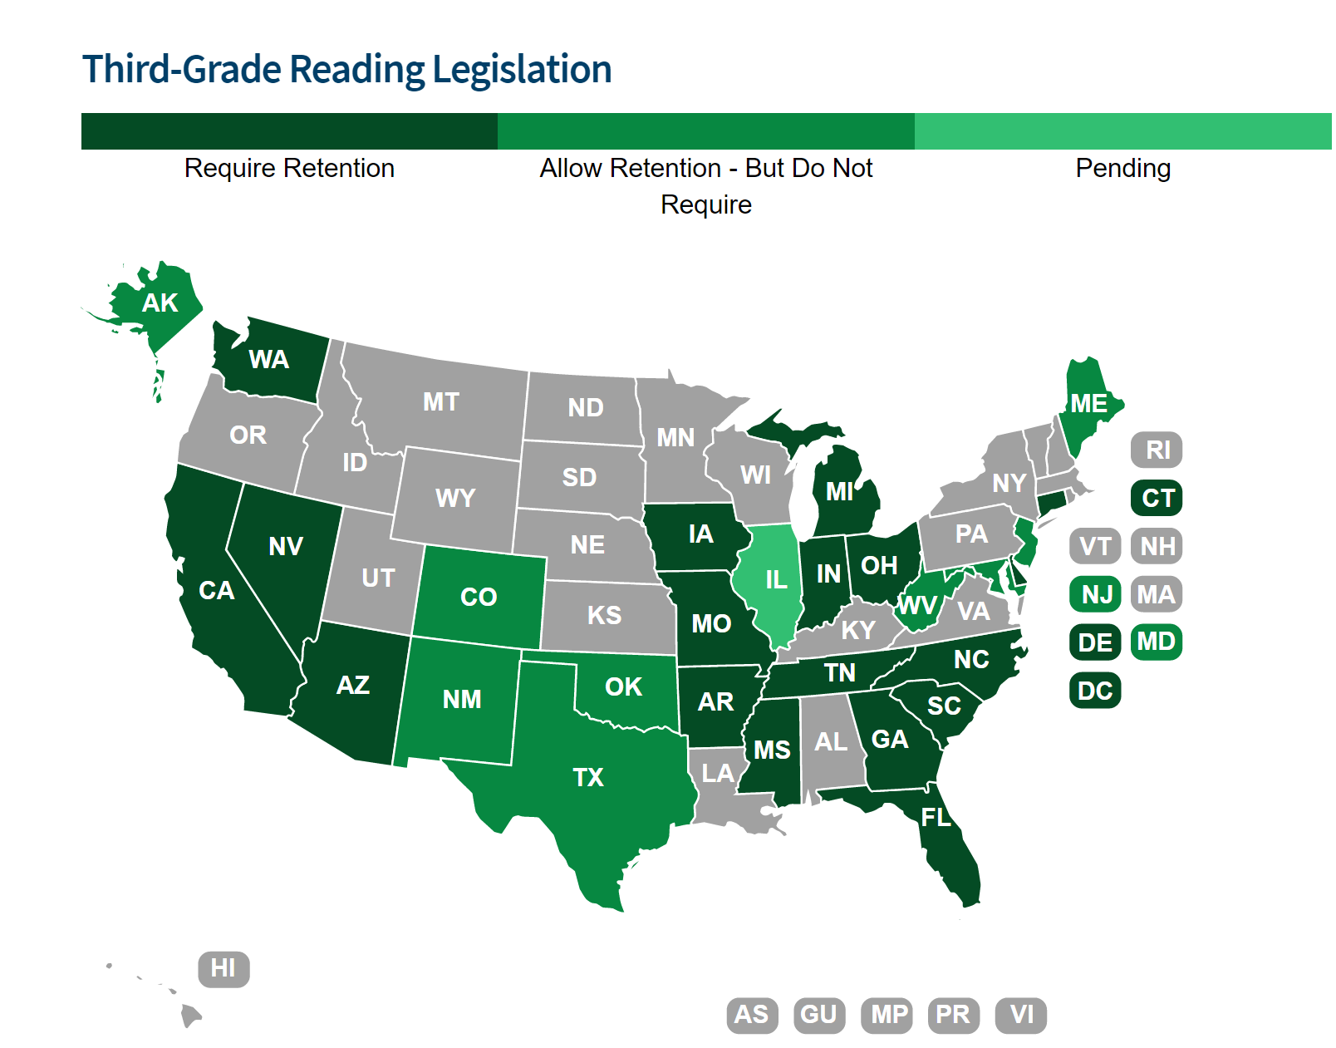
http://www.ncsl.org/research/education/third-grade-reading-legislation.aspx

Slide 17
Education Reform 2012 Iowa Style

Slide 18
State Policy Rationale (ECS Reading/Literacy PK to Third Grade, Dec. 2014 quoting Annie E. Casey Double Jeopardy)
“If children do not have proficient reading skills by third grade, their ability to progress through school and meet grade-level expectations diminishes significantly. These students are at a much greater risk of dropping out, which often leads to high rates of unemployment and increased risk of participation in the criminal justice and welfare systems. Research shows that:
Children who are not reading proficiently by third grade are four times less likely to graduate high school on time.
More than half of all students (63%) who did not graduate from high school on time were not reading proficiently in third grade.”

Slide 19
The Des Moines Iowa Poll in 2016 surveyed Iowans, 67% of whom support retention for readers not at grade level.

Slide 20
Iowa Education Reform 2012 SF 2284
14 major Divisions in the bill, of which Division IX was Early Literacy
Required State BOE to create rules around K-3 local and statewide assessments/tools to assess and monitor reading proficiency
Created the Iowa Reading Research Center: apply current research on literacy to develop and disseminate instructional strategies for PK-12 in reading, comprehension, and writing; identify and provide interventions beginning in K for students at-risk of not reading well; models for school/community partnership to improve literacy; assessments; PD strategies to improve teaching of reading; data on demographics and reading progress; intensive summer literacy program (directed to first focus on K-3 reading)
Required districts to assess Kindergarten readiness in 4-year olds in PK or Head Start
Section 34 is about student progression and remedial instruction

Slide 21
Iowa Education Reform 2012 SF 2284
Reading Deficiency and Parental Notification
Assess every K-3 student at beginning of the year
District provides intensive reading instruction to any student with a substantial deficiency in reading
Reassess with either local or state assessment
Continue with intensive support until deficiency is remedied
Notify parents at least annually: (LB651 says within 15 days after identification of the deficiency) Hey parent, your child has a substantial deficiency in reading and here are the intensive services our school is providing. Describe the proposed supplemental services and supports designed to remediate the deficiency. Here are some strategies for you to use at home. (LB651 includes parents in creation of the individual reading improvement plan)
Beginning in May of 2017, if deficiency isn’t remedied, parent may enroll student in summer school or student will repeat 3rd grade. This policy included a 4-year implementation delay –incoming Kindergarteners received intensive services for all of K-3 before retention consequence. (LB 651 has a 2-year delay, with retention kicking in 2019-20.)
If student completes summer school, achieves proficiency or is eligible for a good cause exemption, go on to grade 4.

Slide 22
What does Summer School/Summer Reading Camps look like?
District “shall provide” reading camps to all students scoring below grade level (LB651, like Iowa, has broadened the summer experience to all students, not just those without an exemption)
Highly qualified teachers, reading credential, proven effective teaching
70 hours of reading instructional time at a minimum
In Iowa, the highly qualified teachers and 70 hours of reading instruction unfolded through administrative rules and Reading Research Center involvement, not through statute.

Slide 23
Exemptions from Mandatory Retention:
LB651
Alternative Assessment grade level proficiency
Portfolio/work samples show mastery of all 3rd grade reading standards
IEP indicating state test isn’t appropriate
LEP with less that 2-year instruction in LEP plan
IEP include intensive reading intervention for more than 2 years and previously retained in K-3
Any student who has received intensive reading intervention for more than 2 years and previously retained in K-3
Student was previously retained in 3rd grade
Iowa Law
LEP with less that 2-year instruction in LEP plan
IEP indicating state test isn’t appropriate
Alternative Assessment/performance measure
Student demonstrate mastery through a portfolio
Any students who has received intensive reading intervention for more than 2 years and was previously retained in K-3 (Iowa law goes on to say intensive diagnostic and instructional support continues)
Completes a summer reading program or achieves proficiency

Slide 24
Process for Exemption:
LB651
Teacher recommends promotion of student who may be exempted from retention to Principal
Principal makes recommendation
Superintendent accepts or rejects principal’s recommendation in writing.
District must notify parents of student being retained
Iowa Law: good cause
School district shall exempt eligible student who qualifies for a good cause exemption from retention
Documentation must include request from student’s teacher to principal that indicates promotion of the student is appropriate and includes IEP, report card, portfolio, if appropriate
Student may not be retained until:

Slide 25
Iowa has presumption of promotion unless. . .
SF 2284 new Code 279.69(3) Promotion to grade four:
In determining whether to promote a student in grade three to grade four, a school district shall place significant weight on any reading deficiency identified pursuant to subsection 1, paragraph “a”, that is not yet remediated.
The school district shall also weigh the student’s progress in other subject areas, as well as the student’s overall intellectual, physical, emotional, and social development.
A decision to retain a student in grade three shall be made only after direct personal consultation with the student’s parent or guardian and after the formulation of a specific plan of action to remedy the student’s reading deficiency.

Slide 26
Delivery of Intensive Services:
LB651 defines intensive services, provided to retained students, including but not limited to the following:
More time on reading and intervention/research based
Daily targeted small group
Reading programs with proven accelerated results
Explicit and systematic instruction with more detailed explanation, more extensive opportunities for guided practice and more opportunities for error correction and feedback.
Administration of assessments to frequently monitor student progress
Before or after-school supplemental reading intervention based in research, delivered by a teacher or tutor with specialized reading training
Read-at-home plan for parents, parental contract with participation in parent training workshops and regular guided home reading
District must provide intensive acceleration class
Report to DE progress of retained students at semester and a host of other things (board policy on retention, #, % and grade of students below grade level and of those retained, # and % of 3rd graders promoted due to exemption, and revisions to retention/promotion policy from prior year’s report.)
IA law defines intensive services, provided to below-proficient K-3 students, which may include but are limited to the following:
Small group instruction
Reduced teacher-student ratios
More frequent progress monitoring
Tutoring or mentoring
Extended school day, week or year
Summer reading programs

Slide 27
L651: After 3rd-Grade focus rather than up Front Investment
Iowa has invested $8 million annually since 2012-13 for early intervention for local school districts plus implemented teacher leadership programs and professional development.
Reading Research Center: studied best practices and analyzed different summer school approaches.
Statewide Voluntary Preschool, free to any four-year-old student, in Iowa public schools or through community partners
Statewide diagnostic and progress monitoring systems (Iowa policy brief: “top district performers saw increases up to 32.2 percentage points. . . In the 2015-16 school year, # of students meeting or exceeding benchmarks grew 4.2% from Fall to Spring, from 63.4% to 67.6%. . . 53 school districts saw double-digit increases.”

Slide 28
Cost $ $ $ $ $
Annual cost per year for each retained student in Nebraska
Summer school costs (including offering to all those students exempt from retention). Don’t forget transportation, meals, shortage of qualified teachers willing to teach in the summer, and attrition of students which doubles your cost (summer school plus retention cost). Rural areas, if like Iowa, won’t have enough students to achieve economy of scale per teacher.
Other processes cost money:
Reduced class sizes / small groups for retained students (staff, space)
Cost of research-based scientifically sound reading programs
Training for staff, including provision of qualified reading teacher before and after school, in summer school, providing intensive services
Staff for ongoing progress monitoring (15 minutes per student X 25 students = 375 mins, or 1 hour and 15 min each instructional day)
Of all the interventions, retention combined with summer school is the most expensive.
Can you compute an expected literacy growth per dollar invested?

Slide 29
Teaching Reading is Rocket Science – and Dr. Deborah Reed at the IRRC is a Rock Star

Slide 30
Iowa Reading Research Center Summer School Study Findings
ISRP Study https://iowareadingresearch.org/sites/iowareadingresearch.org/files/wysiwyg_uploads/2016_isrp_study_report_final.pdf
Compared 3 different models with class sizes of 15 students in 44 different districts: Each class was randomly assigned to be taught by local educators using one of three “conditions” or reading programs: (a) a specific print-based program, (b) a specific computer-based program, (c) a business as usual comparison that could be any type of program, as long as it was not the same as the other two conditions.
Study results show all three conditions used were equally effective at preventing a decline of reading skills that can typically occur during the summer months when away from the classroom.
On average, however, the ISRPs did not lead to statistically significant growth on tests of students’ reading abilities. (If this plays out in NE, your schools will suffer double cost – Summer School costs plus retention costs)

Slide 31
Iowa Reading Research Center Summer School Study Findings
ISRP Study https://iowareadingresearch.org/sites/iowareadingresearch.org/files/wysiwyg_uploads/2016_isrp_study_report_final.pdf
Cost: based on providing ISRPs statewide for the 9,000 3rd-graders not reading proficiently.
The estimated median cost would range from about $9.25 million to just over $13.82 million, depending on whether depreciation of assets and administrator pay were included in the calculation.
The corresponding per pupil expenditures would range from $1,193 to $1,813. Because not all students will be required or choose to attend ISRPs, these figures might be considered the maximum expense.
The study did not include the cost of a student who dropped out of the ISRP then being retained in 3rd grade, or an estimate $6,446 in Iowa.
Challenges: recruiting staff, student attendance/attrition/ program evaluation and planning rigorous reading instruction for 4 hours a day to get to the hours required for the ISRP.

Slide 32
What Makes a Literacy Practice Evidence-Based?
IRRC Brief on understanding “scientific” evidence-based literacy programs. . . . https://iowareadingresearch.org/blog/what-makes-literacy-practice-evidence-based
Experimental randomly assigned instructional strategies . . .show proven results.
Correlational studies are better than no evidence, but don’t meet the higher standard of scientifically based.
Hard-pressed to find any scientifically based studies on the impacts of retention.
L651 requires a higher level of evidence and decision-making at the local level than in the state policy recommendation. Hmmmmmm . . .

Slide 33
Arguments AGAINST Retention, Reading Rockets Sara Briggs, 7/4/2014. http://www.readingrockets.org/article/effects-mandatory-retention
Holding students back lowers their self-esteem and makes them feel inferior, in effect perpetuating their failure. Read more about the Matthew Effect.
Retention impairs peer relationships, cutting off friendships made through the year and subjecting grade-repeating students to ridicule and bullying.
Students may view themselves as further alienated from school and academics rather than grateful for specialized help.
Retained students are more likely to drop out of school.
Studies show temporary increased achievement compared to promoted peers but loss of achievement over time as grade repeaters fall farther and farther behind other low achievers who were promoted.

Slide 34
Arguments AGAINST Retention, Reading Rockets Sara Briggs, 7/4/2014. http://www.readingrockets.org/article/effects-mandatory-retention
Retained students make for larger class sizes, which are more difficult for teachers to manage.
The direct cost of retaining students in America exceeds $12 billion annually.
Research shows increased rates of dangerous behaviors such as drinking, drug abuse, crime, teenage pregnancy, depression, and suicide among retained students compared to similarly performing promoted students.
The effects of having a greater number of grade-retained peers are detrimental to the standardized achievement outcomes of non-retained classmates, a phenomenon often referred to as "the spillover effect."

Slide 35
Brookings “The wisdom of mandatory grade retention,” Brookings, https://www.brookings.edu/research/the-wisdom-of-mandatory-grade-retention/ 9/29/2016
Retention is not nearly as harmful as prior research suggests, but there doesn’t seem to be significant and lasting benefits.
Several studies find that retention is associated with short-term improvements in standardized test scores, but these seem to fade within several years.
None of these “new generation” studies indicate any positive effects on high school completion. (To be fair, they do not find that retention reduces the likelihood of graduation, either.)
It is possible that the threat of grade retention will have an independent effect on student performance by mobilizing school staff and families to more effectively and efficiently utilize early grade interventions.

Slide 36
Hechinger Report Oct. 2014

Slide 37
Andrew targets state policy-makers:
. . .her study is aimed at education policy officials who are deciding whether to have high-stakes tests that determine who moves on and who is held back. “My study is an argument about how a very expensive policy, grade retention, may actually undermine our shared goals of ensuring every child gets a quality education,” she replied. “I would argue that my study is evidence that we might take funds used for an expensive and likely deleterious policy and use them for earlier, pre-school interventions and. . . Supplemental services. . . .to help get a student up to speed.”

Slide 38
Florida Example (Brookings again)
While it’s true that the state saw impressive initial gains in 4th grade reading scores after adopting the (retention) policy in 2002, a rigorous analysis found that by the time kids who repeated 3rd grade reaching middle school, they were no better off than their peers who just missed being retains.
Florida invested nearly $100 million per year in tutoring, summer school, and teacher PD to support early reading at the same time it implemented mandatory retention. It is unclear whether a retention policy alone would have similarly positive effects.

Slide 39
Just a thought:
Studies comparing dropout/completion rates with 3rd-grade retention in 2014 looked at students who weren’t reading at grade level years earlier at a minimum, at least 2005.
How many of your schools have improved literacy practice, both prior to and after third grade, since 2005?
Those correlations may hold true, absent an effective action.
e.g.., Mr. Parish, Meredith Middle School, DMPS (Second Chance Reading, which showed 1 year of reading improvement for 4 months of instruction)

Slide 40
What supports can districts and states implement to improve literacy?
Effective instruction (using instructional strategies and models that have a high impact on student learning)
Systems of early detection, monitoring and screening (along with PD about what to do differently – see #1)
Effective preschool (about half the cost of retention, but lowers the likelihood of special education and dropout, so long term economic benefit and other offsetting savings.)
Develop, encourage and support parent engagement in literacy
Extended year effective programming (before and afterschool, summer school)
Community support of struggling children and families

Slide 41
Noteworthy: Iowa State Budget Trouble
Agricultural sector struggling with $3+ corn
Phased in tax credits and property tax relief both hit the state budget
In the 2017 Session, revenues growth projections were lowered twice, forcing the Iowa leaders to initially cut $110 million and then borrow another $131 million from economic emergency funds.
There was no new money – so education community made the case that continued investment in early literacy ($7.2 million instead of $8 million, but significant nonetheless) was more important for students than paying for summer school and retention.

Slide 42
Intersection of Core Values and Public Policy

Slide 43
Core Values of Conservative Politics and Educational Policy
“Public leadership is more than the leadership skills of individuals who happen to be public officials. Public leadership is how we make collective decisions that help create the good life for everyone and affirm the values of our democratic society.”
–Phillip Boyle, Nations Cities Weekly, Sept. 12, 2005

Slide 44
What is the “good life”? (Core Values Inherent in our Democracy)
____________________________________
____________________________________
____________________________________
____________________________________

Slide 45
“Public decisions involve choices and public choices always involve values.”
Liberty: freedom, autonomy, choice, opportunity, individuality, privacy;
Community: safety, security, belonging, social order, quality of life;
Equality: fairness, justice, tolerance, diversity, equal treatment, equal opportunity; and
Prosperity: productivity, efficiency, growth, markets.
Boyle, Local School Board Governance, Spring 2004

Slide 46
Tension – These Values Compete – More of one means less of another
Liberty
Community
Prosperity
Equality

Slide 47
Core Values in the Retention Debate
Prosperity: School resources, taxes, stewardship of public investment, successful student is a contributing adult, unfunded mandates
Liberty: local control (district, teacher and parent freedoms), compliance with state mandates is the opposite of district freedom, local educators and leaders know their students best
Community: belonging and quality of life is harmed by retention, retention correlates to increased social ills/criminal activity, reading is essential skill of democracy, local educators care deeply about student success
Equality: all students must learn to read to be successful, equal treatment/equal opportunity (interventions must happen before and after 3rd grade), also about investment ($ and support) for teachers and schools

Slide 48
Core Values: CLEP
C______________________
L______________________
E______________________
P______________________

Slide 49
So what did we do in Iowa to Repeal 3rd Grade Retention Mandate? Appealed to core values:
P L
Summer School and Retention are unfunded mandates
ESSA allows parents to opt out of testing
Reading Research Center study showed lack of significant reading improvement in summer school with significant cost
Tight state budget meant priority setting: early literacy investment was more important for student success than summer school or retention
E L
E P
E C

Slide 50
Advocacy Steps and Messages
http://www.afterschoolalliance.org/STEM-toolkit.cfm

Slide 51
“That so few people vote, that far fewer write letters or make phone calls to politicians and almost none give money or time, gives disproportionate power to those who do.”
Joel Blackwell, The Grassroots Guy

Slide 52
If Legislators aren’t listening:
Are they hearing consistent messages from the education groups?
Is it you? Are you appealing to their core values, listening and responding to them?
Start and end with a thank you
Keep it brief – one page, simple and clear – what do you want and why?
Ask for commitment: can we count on your support?
Follow-up – again with thanks and ask again for commitment.
Foster new relationships and strengthen existing ones
You don’t need everyone – 8 Education Committee members, 49 Senators, Speaker, Governor. Pick your battles and your champions.

Slide 53
Who else could care?
Who has provided financial support to a Senator?
http://www.dataomaha.com/campaign-finance
Have you or someone you know personally supported a candidate?
Organizations: main street businesses, or other entities who care about quality of workforce, reducing dropout rates, etc.
Parents, parents, parents, parents. . . . .
Iowa Business Council was chief advocate for Universal PK in Iowa (saves taxpayer money in the long run)
Media – need something to write about.

Slide 54
Lobby by Proxy: show others are with you
Educate others to whom the Senators listen
Write or recruit others to write letters to the editor (stories and shared research findings.)
Examples: Sue Brugman, Clay Central Everly School Board (resolutions) and Grandma Shirley in Keota (pizza and letters)
Tell successes of early interventions – teachers can inform parents and parents can write letters to the editor

Slide 55
It’s about Leadership: Examples
Dr. Eric Witherspoon: 25% of his job was advocacy
Dr. Tom Lane: 30 minutes at the beginning of every day
Dr. Jane Lindaman and Nancy Turner: Get legislators in your schools
If everyone in this room could get 3 citizens to write a letter, it would be a groundswell of public opinion
Tell stories and share the research, but tell stories

Slide 56
It’s a funny thing. The more I practice, the luckier I get.” Arnold Palmer

Slide 57
“Decisions are made by those who show up.”
President Jed Bartlett, The West Wing
(or Harry Truman)

Slide 58
Never doubt that a small group of thoughtful, committed citizens can change the world; indeed, it's the only thing that ever has.
Margaret Mead

Slide 59
Questions or Comments?
MARGARET BUCKTON – ISFIS PARTNER
CELL: 515-201-3755
Margaret@iowaschoolfinance.com
Iowa School Finance Information Services
1201 63rd Street
Des Moines, IA 50311
Office: 515-251-5970
www.isfis.net

