Slide 1
ACA Reporting Forms
Justin Knight

Slide 2
(402) 570-9472 Questions or Technical Issues

Slide 3
Today

Slide 4
1/20/17
Inauguration
Today

Slide 5
1/20/17
Inauguration
Today
1/31/17
1095-C to Employees

Slide 7
3/2/17
1095-C to Employees
1/20/17
Inauguration
Today

Slide 8
3/2/17
1095-C to Employees
1/20/17
Inauguration
Today
2/28/17
1095-C to IRS
(paper)
3/31/17
1095-C to IRS
(electronic)

Slide 9
The Forms
> 50 FTE
Including 50-99

Slide 10
The Forms
1094-C
1095-C

Slide 12
1094-C

Slide 13
1094-C

Slide 14
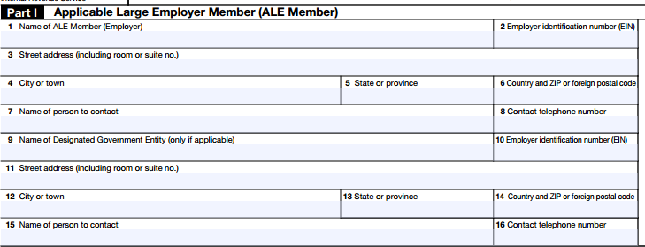
1094-C

Slide 15
1094-C

Slide 16
1094-C

Slide 17
1094-C

Slide 18
1094-C
Number of full-time employees

Slide 19
1094-C

Slide 20
1094-C

Slide 21
1094-C
Number of full-time employees

Slide 22
1094-C

Slide 23
1094-C

Slide 24
1094-C

Slide 25
1094-C

Slide 26
Line 22: A (QOM)
At least 1 full-time EE
For all months that penalty could apply
< $94.05 per month

Slide 27
Line 22: A (QOM)
Fed. Pov. Line: $11,880
Divided by 12
Multiplied by 9.5%
= $94.05

Slide 28
Line 22: C (TR)
Probably only the 50-99 districts

Slide 29
Line 22: D (98%)
All months (except meas. period)
Affordable coverage to 98% of FT EE’s

Slide 30
1094-C

Slide 31
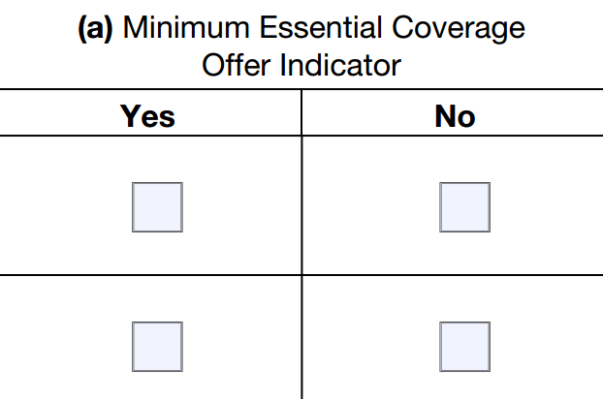
1094-C

Slide 32
1094-C
95% FT
Each month
TR counts as “yes”

Slide 33
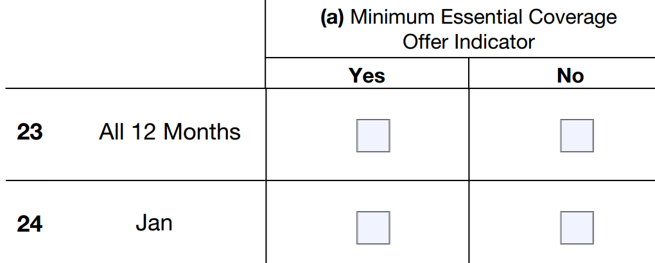
1094-C

Slide 34
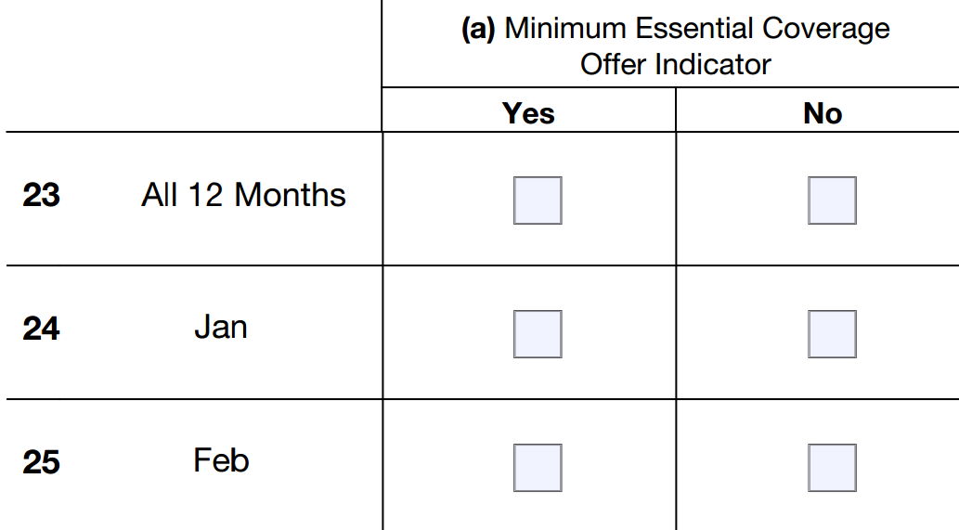
1094-C

Slide 35
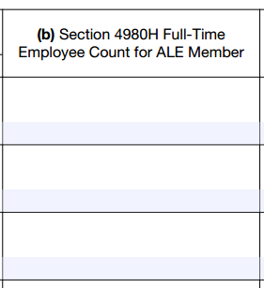
1094-C

Slide 36
1094-C

Slide 37
1094-C
Not required if 98% Method
Line 22, Box D

Slide 38
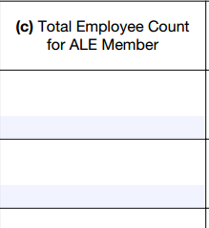
1094-C

Slide 39
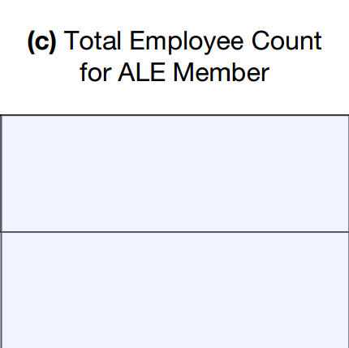
1094-C
1st day month
12th day month
Last day month
1st day payroll
Last day payroll

Slide 40
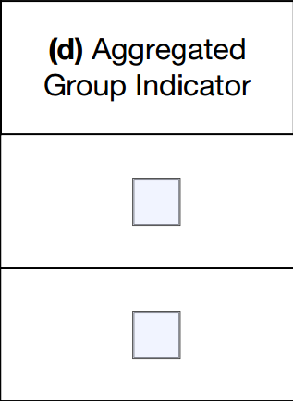
1094-C

Slide 41
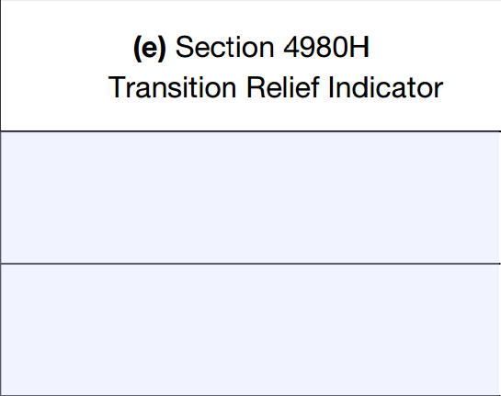
1094-C

Slide 42
1094-C
A: 50-99
B: 100+

Slide 43
1094-C
50-99 Districts: Enter “A” for January through August

Slide 44
1094-C

Slide 45
1095-C

Slide 46
1095-C

Slide 47
1095-C

Slide 48
1095-C
Only FT Employee during any month

Slide 49
1095-C

Slide 50
1095-C

Slide 51
1095-C

Slide 52
1095-C

Slide 53
1095-C

Slide 54
1095-C

Slide 55
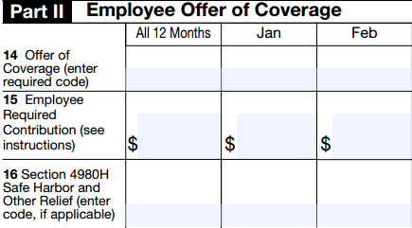
1095-C

Slide 56
1095-C

Slide 57
1095-C
1A: QO
1E: Offer, but not QO
1H: No Offer

Slide 58
1095-C
1I: Transition Relief - Removed
1J: Conditional Offer
1K: Conditional Offer”

Slide 59
1095-C
1A: QO
1E: Offer, but not QO
1H: No Offer

Slide 60
1095-C

Slide 61
1095-C
v.
2016
2015

Slide 62
1095-C
Employee share of: Lowest cost, employee-only health insurance

Slide 63
1095-C

Slide 64
1095-C
2A: Not employee on any day of month

Slide 65
1095-C
2B: Not full-time employee OR full-time employment ended

Slide 66
1095-C
2C: Enrolled in coverage

Slide 67
1095-C
2D: In measurement period

Slide 68
1095-C
2F: Form W-2 Safe Harbor

Slide 69
1095-C
2G: FPL Safe Harbor

Slide 70
1095-C
2H: Rate of Pay Safe Harbor

Slide 71
 | Employment Terminated | Employment Continues
Line 14 | 1H | 1B/1E/Etc.
Line 16 | 2A/2B | 2B
1095-C

Slide 72
1095-C

Slide 73
Penalties?
Forms

Slide 74
Penalties:
$260 per form (1094-C)
Forms

Slide 75
Penalties:
$260 per form (1094-C)
$260 per form (1095-C)
Forms

Slide 76
Penalties:
$260 per form (1094-C)
$260 per form (1095-C)
“Good Faith” Defense
Forms

Slide 77
Providing to Employees:
Forms

Slide 78
Providing to Employees:
Mail
Hand-Deliver
Forms

Slide 79
Providing to Employees:
Mail
Hand-Deliver
Email (w/ consent)
Forms

Slide 80
Need more time:
Forms

Slide 81
Need more time:
Automatic 30-Day Ext. (Form 8809)
Not for 1095-C to EE’s
Forms

Slide 82
Software companies:
Forms

Slide 83
Software companies:
Be prepared
Plan ahead
Forms

Slide 84
Questions?

Slide 85
ACA Reporting Forms
Justin Knight

